Slide 1
Lecture 14: Independent Sample t-test
Jibo He, Ph.D.
Associate Professor
Wichita State University
jibo.he@Wichita.edu

Slide 2
Research Considerations with Independent Samples
Independent samples: the selection of elements making up one sample is unrelated to the selection of elements in another sample
There are two ways in which we can achieve independent samples:
1. Random selection
2.Random assignment

Slide 3
Examples: Independent Samples
1. A researcher wants to see if teachers in two different school districts spend different amounts of time teaching phonics. The researcher obtains complete lists of elementary school teachers in each district and randomly selects 50 teachers from each district to participate in the study.
2. A dietician wants to see if a sugar-free diet will be more effective for weight loss than a low-fat diet. She selects a group of patients who need to lose weight and randomly assigns half of the patients to a sugar-free diet and half of the patients to the low-fat diet.

Slide 4
Examples: Independent Samples
3. A medical researcher wants to see if a new drug reduces recovery time in old patients who are recovering from a broken hip. The researcher randomly assigns some patients to a treatment group, which receives the new drug in addition to physical therapy and other standard treatment, and other patients to a control group, which receives a placebo in addition to physical therapy and other standard treatment.

Slide 5
Statistical Hypotheses
When we conduct a hypothesis test on independent groups we look at the difference between the two population means.
Statistical hypotheses with a non-directional alternative:
Statistical hypotheses with directional alternatives:
(a)
(b)

Slide 6
Statistical Hypotheses
Warning!!
We have to be very careful in specifying our null and alternative hypotheses in situations with two groups when testing directional hypothesis because THE ORDER OF THE GROUPS MATTERS
For example:
If we use the example with the medical researcher, suppose that “group 1” is the treatment group and “group 2” is the placebo group. Using a subscript “t” to represent treatment and a subscript “p” to represent placebo, the population parameter of interest is μ_{t} - μ_{p}

Slide 7
Statistical Hypotheses
If the researcher expects the treatment population to have a shorter recovery time than the placebo population, then we would expect μ_{t}-μ_{p} to be a negative number. That is, if the researcher’s hypothesis is correct, we expect μ_{t}-μ_{p} to be less than zero, and our alternative hypothesis reflects this by stating H_{A}: μ_{t}-μ_{p}< 0
However, had the research specified “group 1” as the placebo group and “group 2” as the treatment group, we would expect μ_{p}-μ_{t} to be a positive number, and our alternative hypothesis would have been
H_{A}:μ_{p}-μ_{t}> 0

Slide 8
Statistical Hypotheses
Whatever order you choose for the groups when you specify the statistical hypotheses is the order that you keep for the groups for the remainder of the hypothesis test (particularly when you compute the test statistic).

Slide 9
Next Steps
Figure out a sample statistic?
In one-sample test, it is the sample mean
Sketch out the sampling distribution of the sample statistic?
In one sample Z-test, the sampling distribution is a normal distribution
In one sample T-test, the sampling distribution is a t-distribution

Slide 10
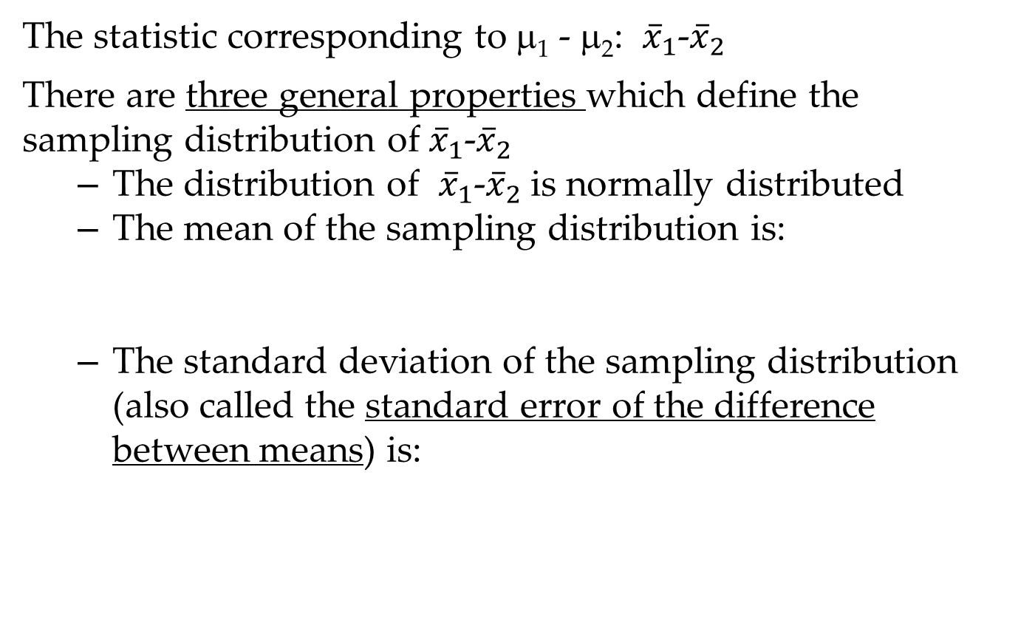
Test statistic
The statistic corresponding to μ₁ - μ₂: -
There are three general properties which define the sampling distribution of -
The distribution of - is normally distributed
The mean of the sampling distribution is:
The standard deviation of the sampling distribution (also called the standard error of the difference between means) is:

Slide 11
Typically, we do not know and since they are population parameters, so we MUST estimate the value of the standard error of the difference between means using the sample variances:
Note:
The standard error of the difference between means is a measure of how much sample fluctuation one would observe if drawing different data sets.

Slide 12
Underlying Assumptions for the Two Sample t Test for Independent Groups
1. Scores on the dependent variable are measured independently both within and across treatments
2. Scores on the dependent variable are normally distributed in each population (i.e. each treatment group)
3. Homogeneity of variance, the variances in the two populations from which the samples are drawn are the same. In symbolic notation

Slide 13
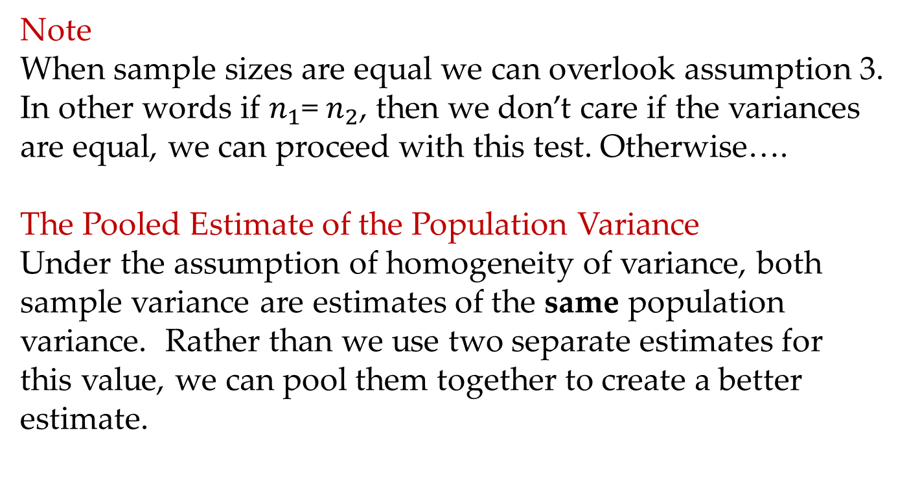
Underlying Assumptions
Note
When sample sizes are equal we can overlook assumption 3. In other words if = , then we don’t care if the variances are equal, we can proceed with this test. Otherwise….
The Pooled Estimate of the Population Variance
Under the assumption of homogeneity of variance, both sample variance are estimates of the same population variance. Rather than we use two separate estimates for this value, we can pool them together to create a better estimate.

Slide 14
The Pooled Estimate of the Population Variance
Pooled estimate of the population variance ( ): a single estimate of the population variance based on combining the data from both samples

Slide 15
Recall that the standard error of the difference between means ( ) is the standard deviation of the sampling distribution of
We can now estimate the value of the standard error of the difference between means using the pooled estimate of the population variance:

Slide 16
The t Statistic used in Testing Hypotheses regarding μ₁-μ₂
The test statistic that we construct using the standard error with the pooled estimate of the population variance will be a t statistic:
The degrees of freedom for this statistic are computed as: df = n1 + n2 – 2
Critical values are obtained using a t distribution table just as for the One Sample t Test

Slide 17
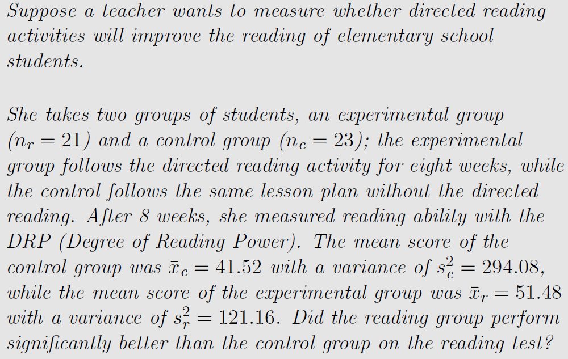
Independent t test: Example 1

Slide 18



To summarize the information we get
A researcher wonders whether a directed reading activity improves reading scores relative to a control group
She randomizes 44 children into two groups
She found the mean DRP score for each group after 8 weeks
And each group came with a sample variance
Does the reading activity change the reading scores?

Slide 19

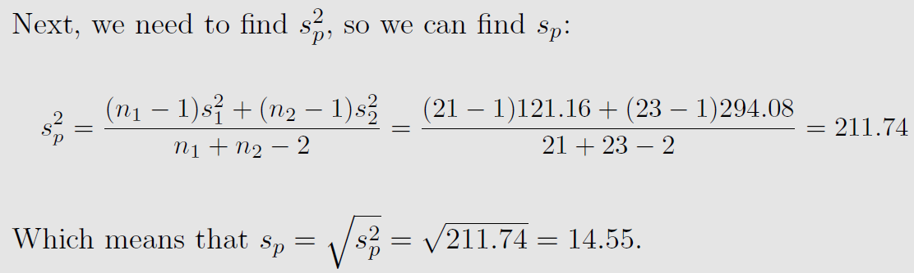
Study hypothesis
Two questions you should always keep in mind
What does 211.74 estimate?
Under what assumption is this estimate valid?

Slide 20
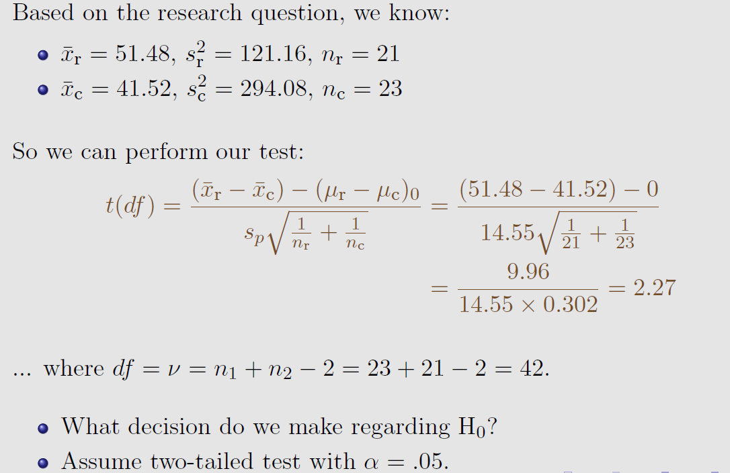

Slide 21
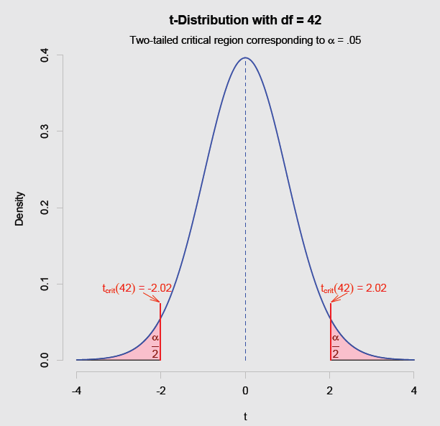
Decision—Find critical value

Slide 22
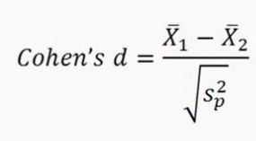
Effect Size
Cohen’s d
d =0.2, small effect
d =0.5, medium effect
d =0.8, large effect
Notes:
https://i.ytimg.com/vi/wGlbyNBxEM8/maxresdefault.jpg

Slide 23
Example 2
Example 2: A researcher is interested in the effectiveness of different methods of teaching reading skills to elementary school students. The researcher obtains a sample of 15 students taught using the whole word method and a sample of 15 students taught using phonics. The researcher then administers a test of reading fluency to all students in the study. The scores obtained by students in the two groups are shown in the table on the next page. Conduct an appropriate test at the .05 level of significance.

Slide 24
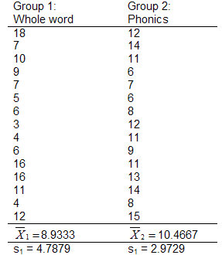
Example 2:

Slide 25
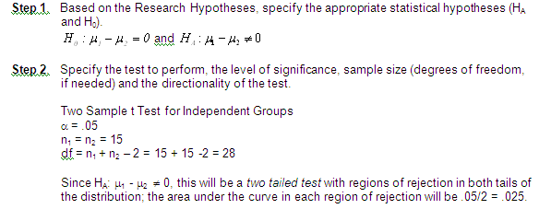

Slide 26
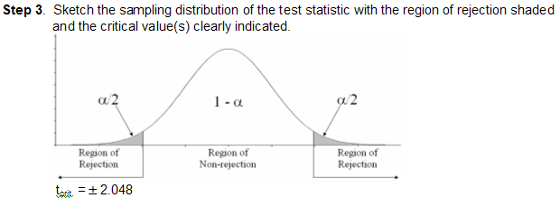
Examples Using the Two Sample t Test for Independent Groups

Slide 27
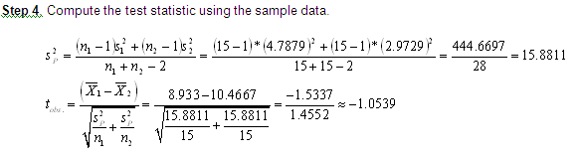
Examples Using the Two Sample t Test for Independent Groups

Slide 28
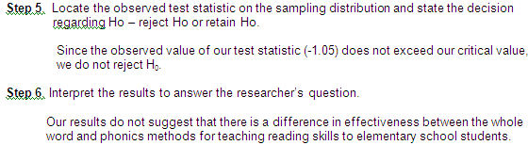

Slide 29
Independent sample T-Test
IntroQ Questionnaire
At the beginning of each semester, I ask each student to answer on paper (no names) each of these questions. I explain that nobody is required to do this, but that the information would be handy for us to use to learn how to do basic descriptive statistics.
A. What is your sex (gender)? Female (1) or Male (2)
B. What is the height in inches of your ideal mate?

Slide 30
Independent sample T-Test in R
#Independent Samples T Tests with R
#http://core.ecu.edu/psyc/wuenschk/R-Lessons/R-t_Independent-Samples.pdf
#install.packages("psych")
library(psych)
introq <- read.table("/Users/hejibo/Documents/Courses to teach /PSY 301 Psychological Statistics course/Psychological-Statistics/Lecture 14_Independent t-test/R independent sample t-test/IntroQ.csv", header=TRUE, sep=",")
describeBy(introq$Ideal, introq$Gender)
t.test(introq$Ideal ~ introq$Gender)

Slide 31
Independent sample T-Test in R
#Independent Samples T Tests with R
#http://core.ecu.edu/psyc/wuenschk/R-Lessons/R-t_Independent-Samples.pdf
#install.packages("lsr")
#install.packages("compute.es")
#install.packages("psych")
library(psych)
introq <- read.table("/Users/hejibo/Documents/Courses to teach /PSY 301 Psychological Statistics course/Psychological-Statistics/Lecture 14_Independent t-test/R independent sample t-test/IntroQ.csv", header=TRUE, sep=",")
describeBy(introq$Ideal, introq$Gender)
t.test(introq$Ideal ~ introq$Gender)
### additional good to know -
### effect size for independent sample t-test
library(lsr)
cohensD(introq$Ideal~ introq$Gender)
library(compute.es)
des(d=1.487092, n.1=539, n.2=180)

Slide 32
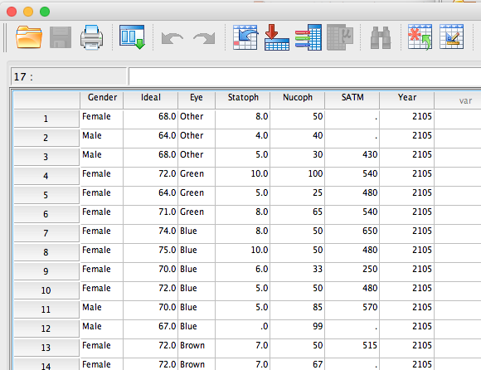
Independent sample T-Test in SPSS

Slide 33
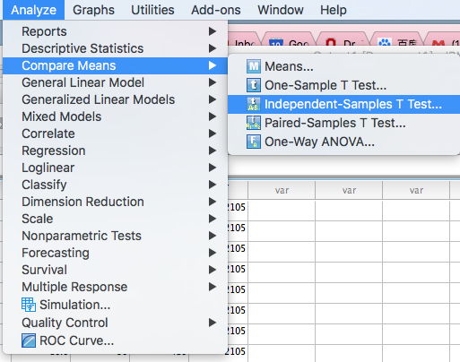
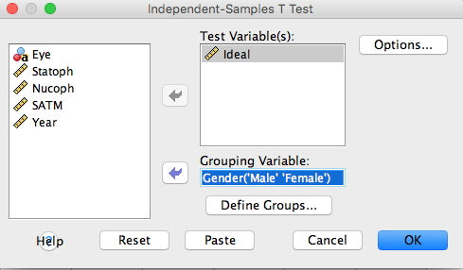
Independent sample T-Test in SPSS

Slide 34
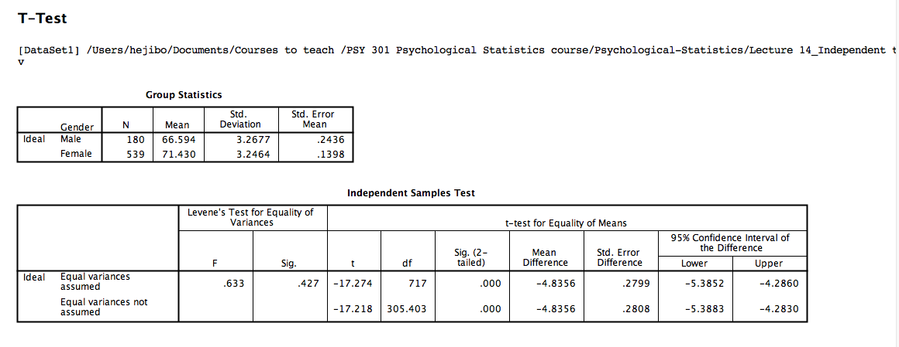
Independent sample T-Test in SPSS

Slide 35
Report results in APA style
Students in Professor Karl’s undergraduate statistics classes completed a brief survey. They were asked to indicate their sex/gender and the height, in inches, of their ideal mate. Mean height of ideal mate was significantly greater for female students (M = 71.43, SD = 3.25, n = 539) than for male students (M = 66.59, SD = 3.27, n = 180), t(717) = 17.27, p < .001, d = 1.49, 95% CI [1.30. 1.67].

Slide 36
Summary
Compare with one-sample t test
Independent sample t-test
Assumptions
Pooled sample variance
T-test statistic, degrees of freedom

